Slide 1
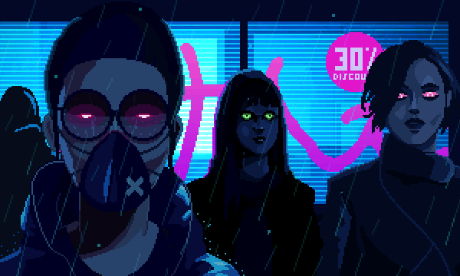
Technology Advances the Future
Mask Buddy

Slide 2

Team Members:
Tyler Stevens-Software designer
Anika Bhattacharya-Product designer
Fernando Rico-Presentation Design/Creation
Notes:
Pictures?

Slide 3
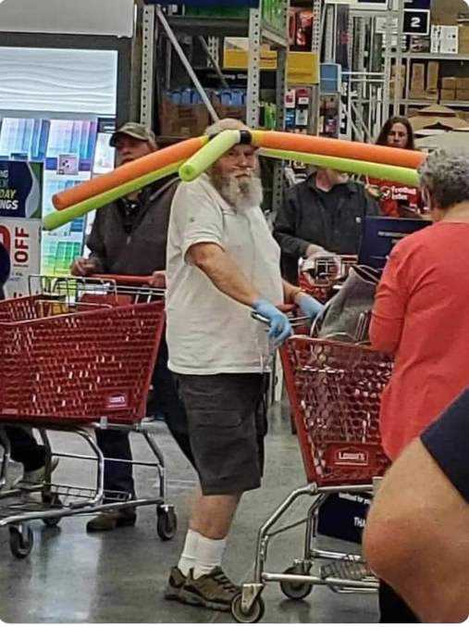
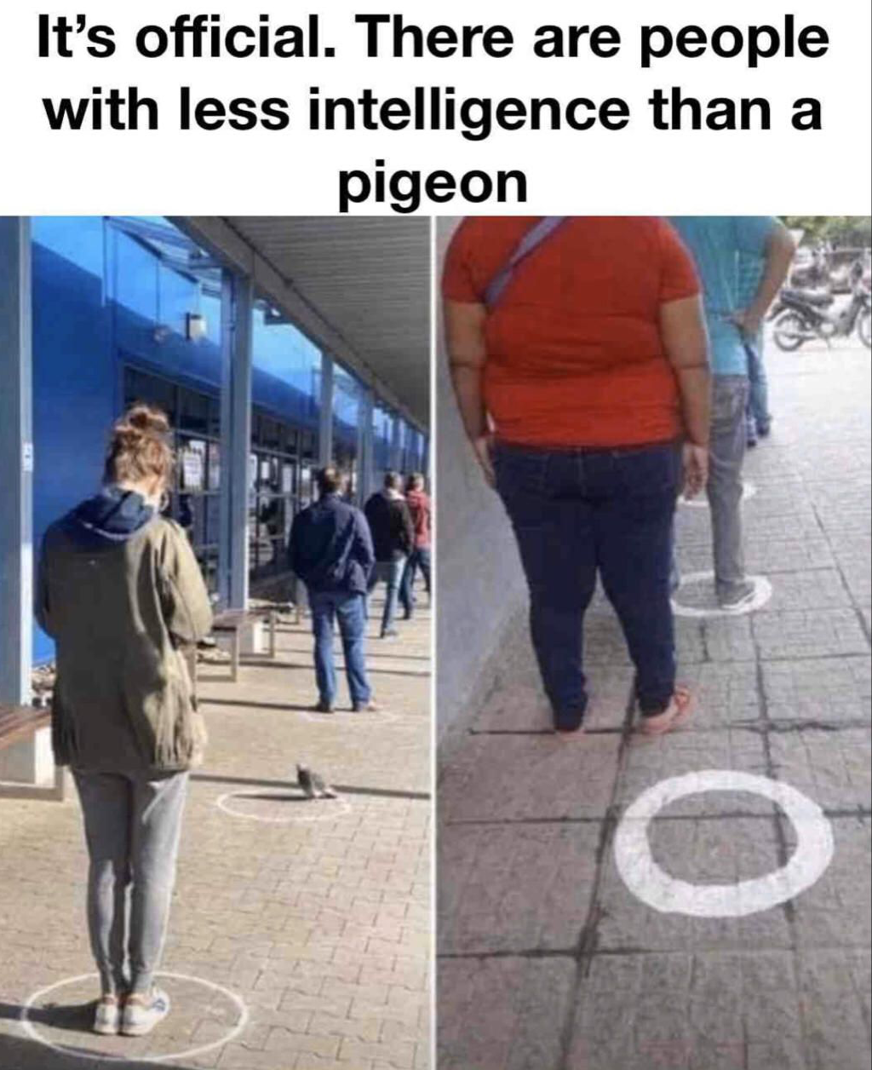
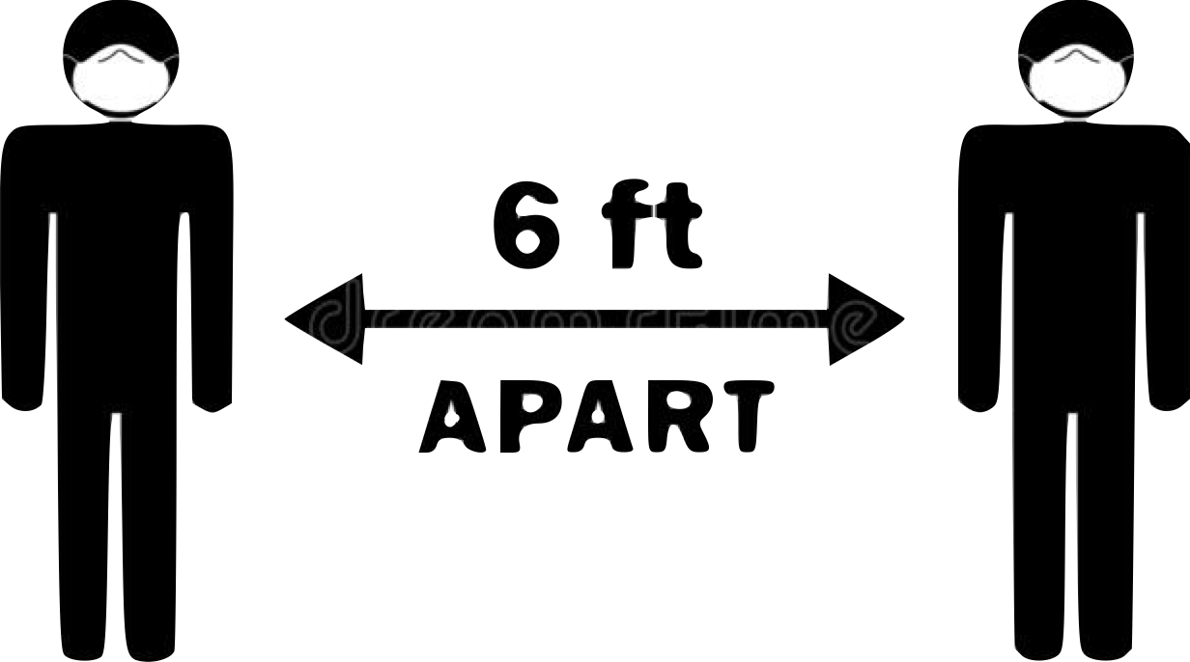
Problem
Solution
-Since COVID arose there has been many implementations to help reduce the spread, major ones being Social Distancing and wearing a Mask
-People become unaware that they are not socially distancing
-We created a mask that helps remind people to socially distance themselves

Slide 4


Mask Buddy:
Functions:
-Since the start of COVID 19 the thing we missed most was human Interaction, to help combat this issue we created Mask Buddy
-Mask Buddy adds a new level of interactions during these hard times
-Mask Buddy helps express your emotions to others while keeping you safe
-Smile and let others know you are enjoying quality time with them
-Or when you social battery dies out you can let them know that you are done talking with them

Slide 5
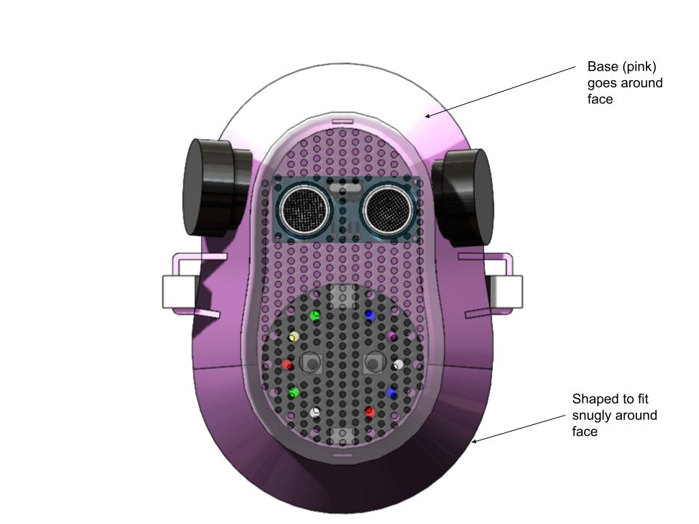
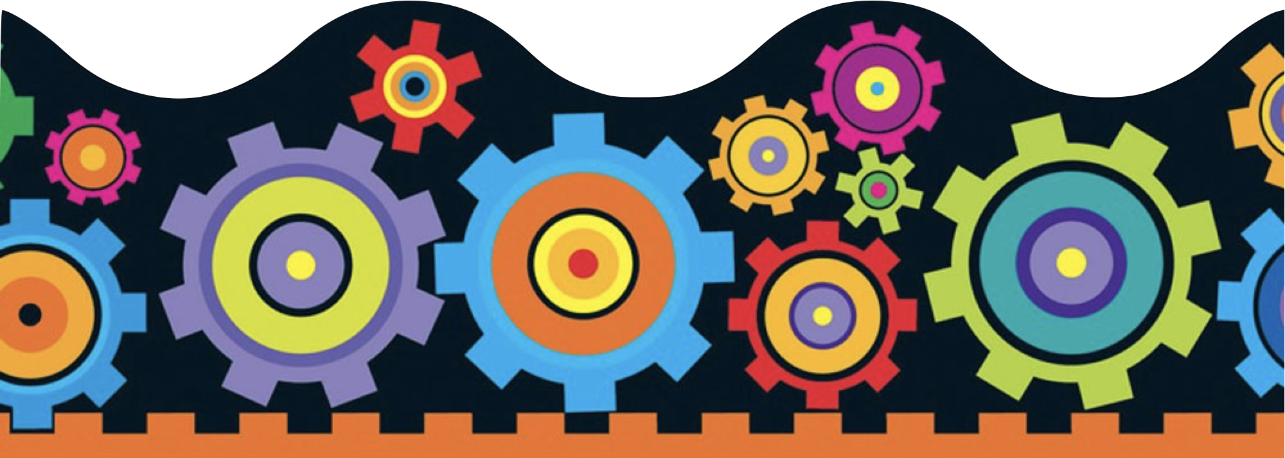
Design-Front

Slide 6
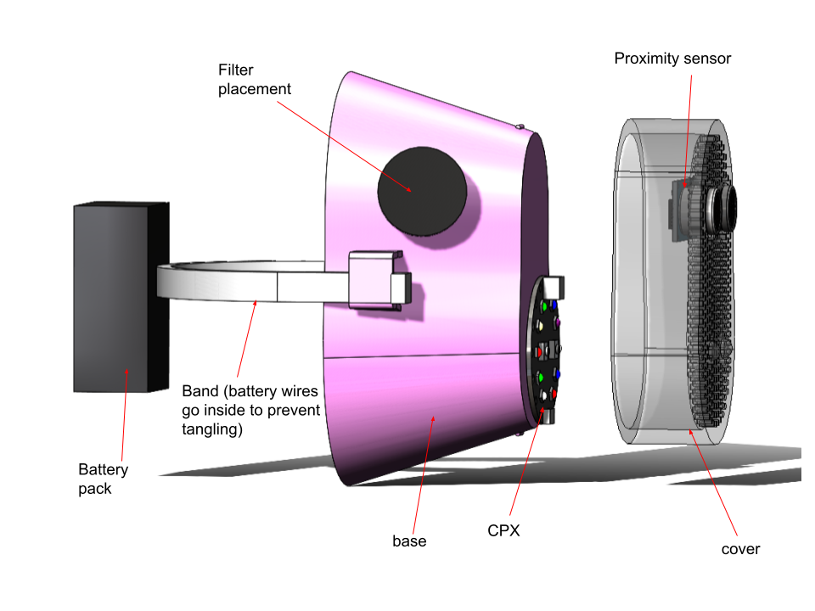
Different Angles

Slide 7

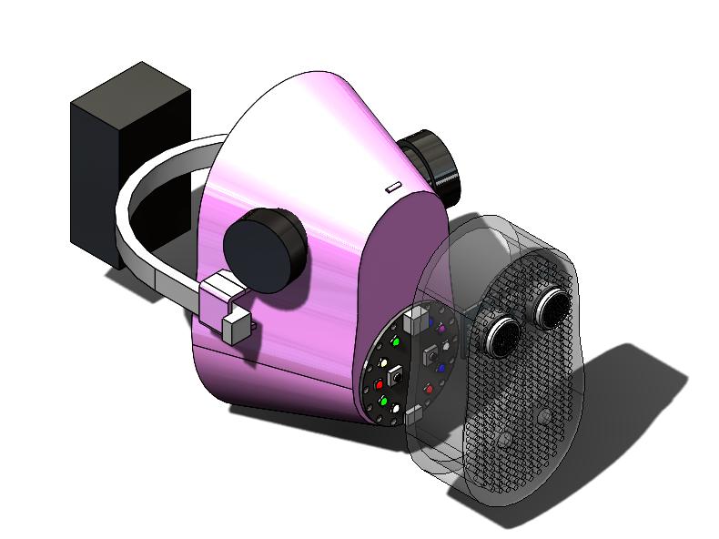
Design Process
Needs to be comfortable to wear
Make usable
Holes for proximity sensor
Sensors need to be able to function
Holes for LED

Slide 8
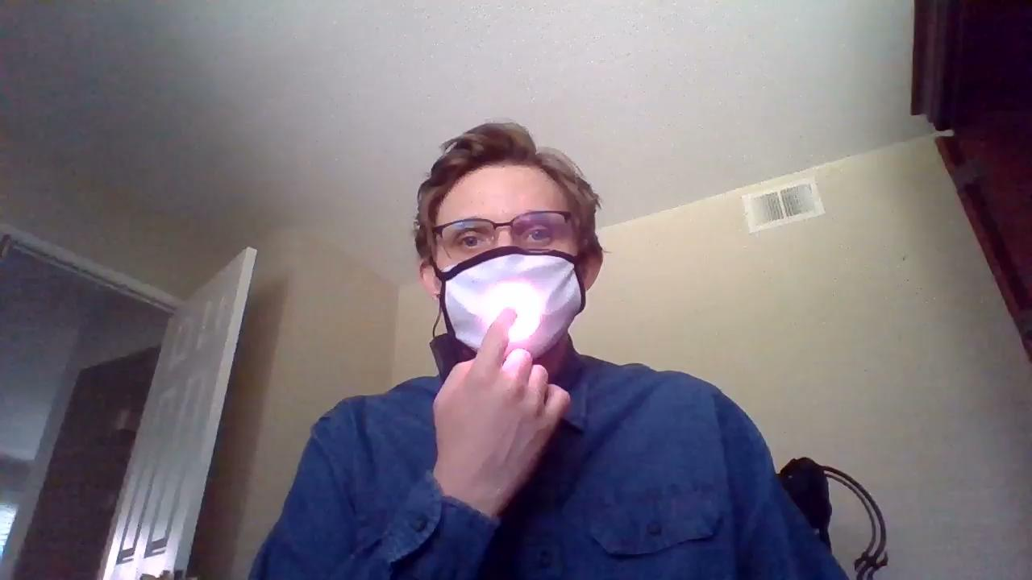

Demo :
Notes:
Here we will have the video of the mask working in action

Slide 9
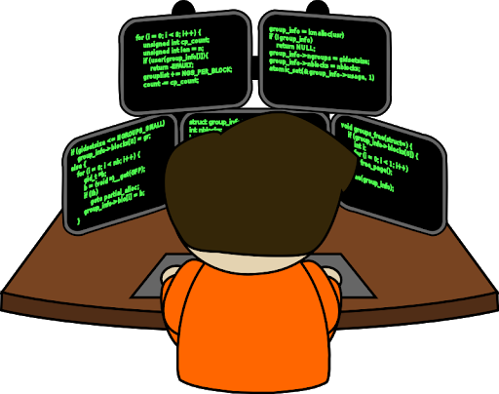
Software:

Slide 10
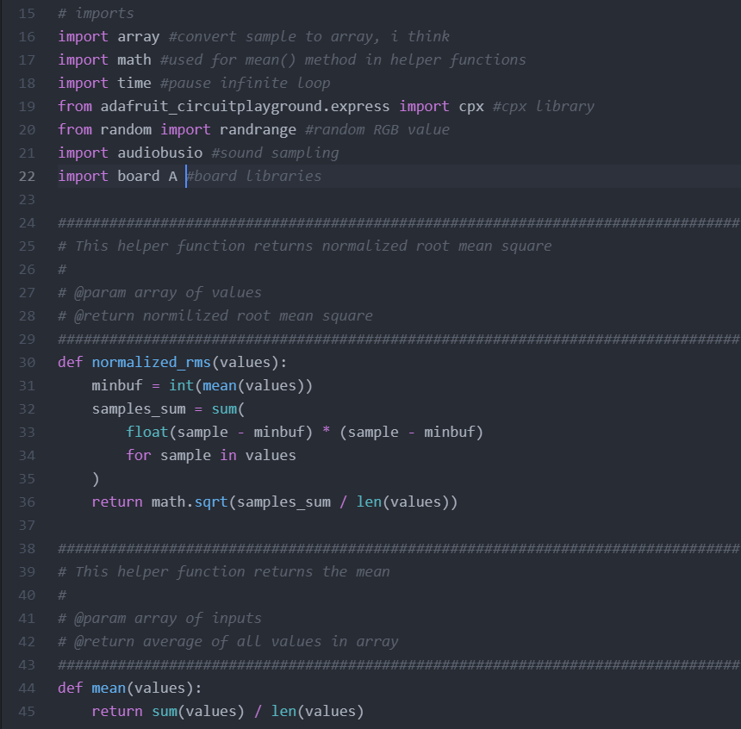
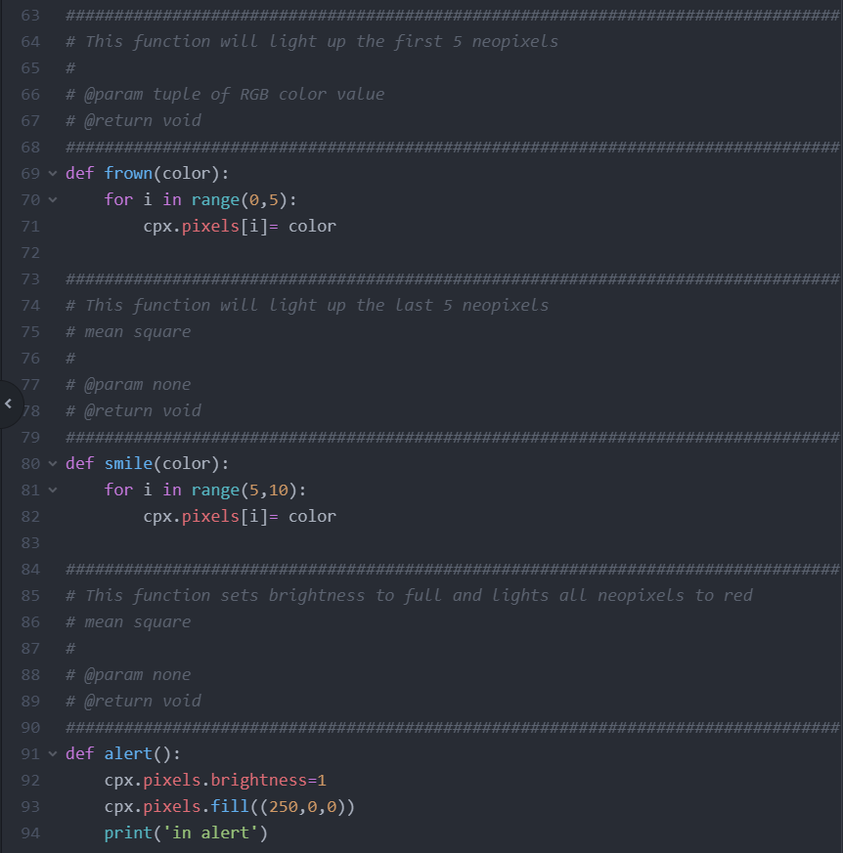
Software:
Used to turn on first 5 light of cpx
Used to normalize sound
sensor samples
Used to turn on last 5 light of cpx
Used to turn on all lights at full brightness
and the color to red
Used to average out sound
sensor samples
Notes:
Here we will have the code and then we can explain the different parts and relate them to the previous slide where the audience saw it working

Slide 11
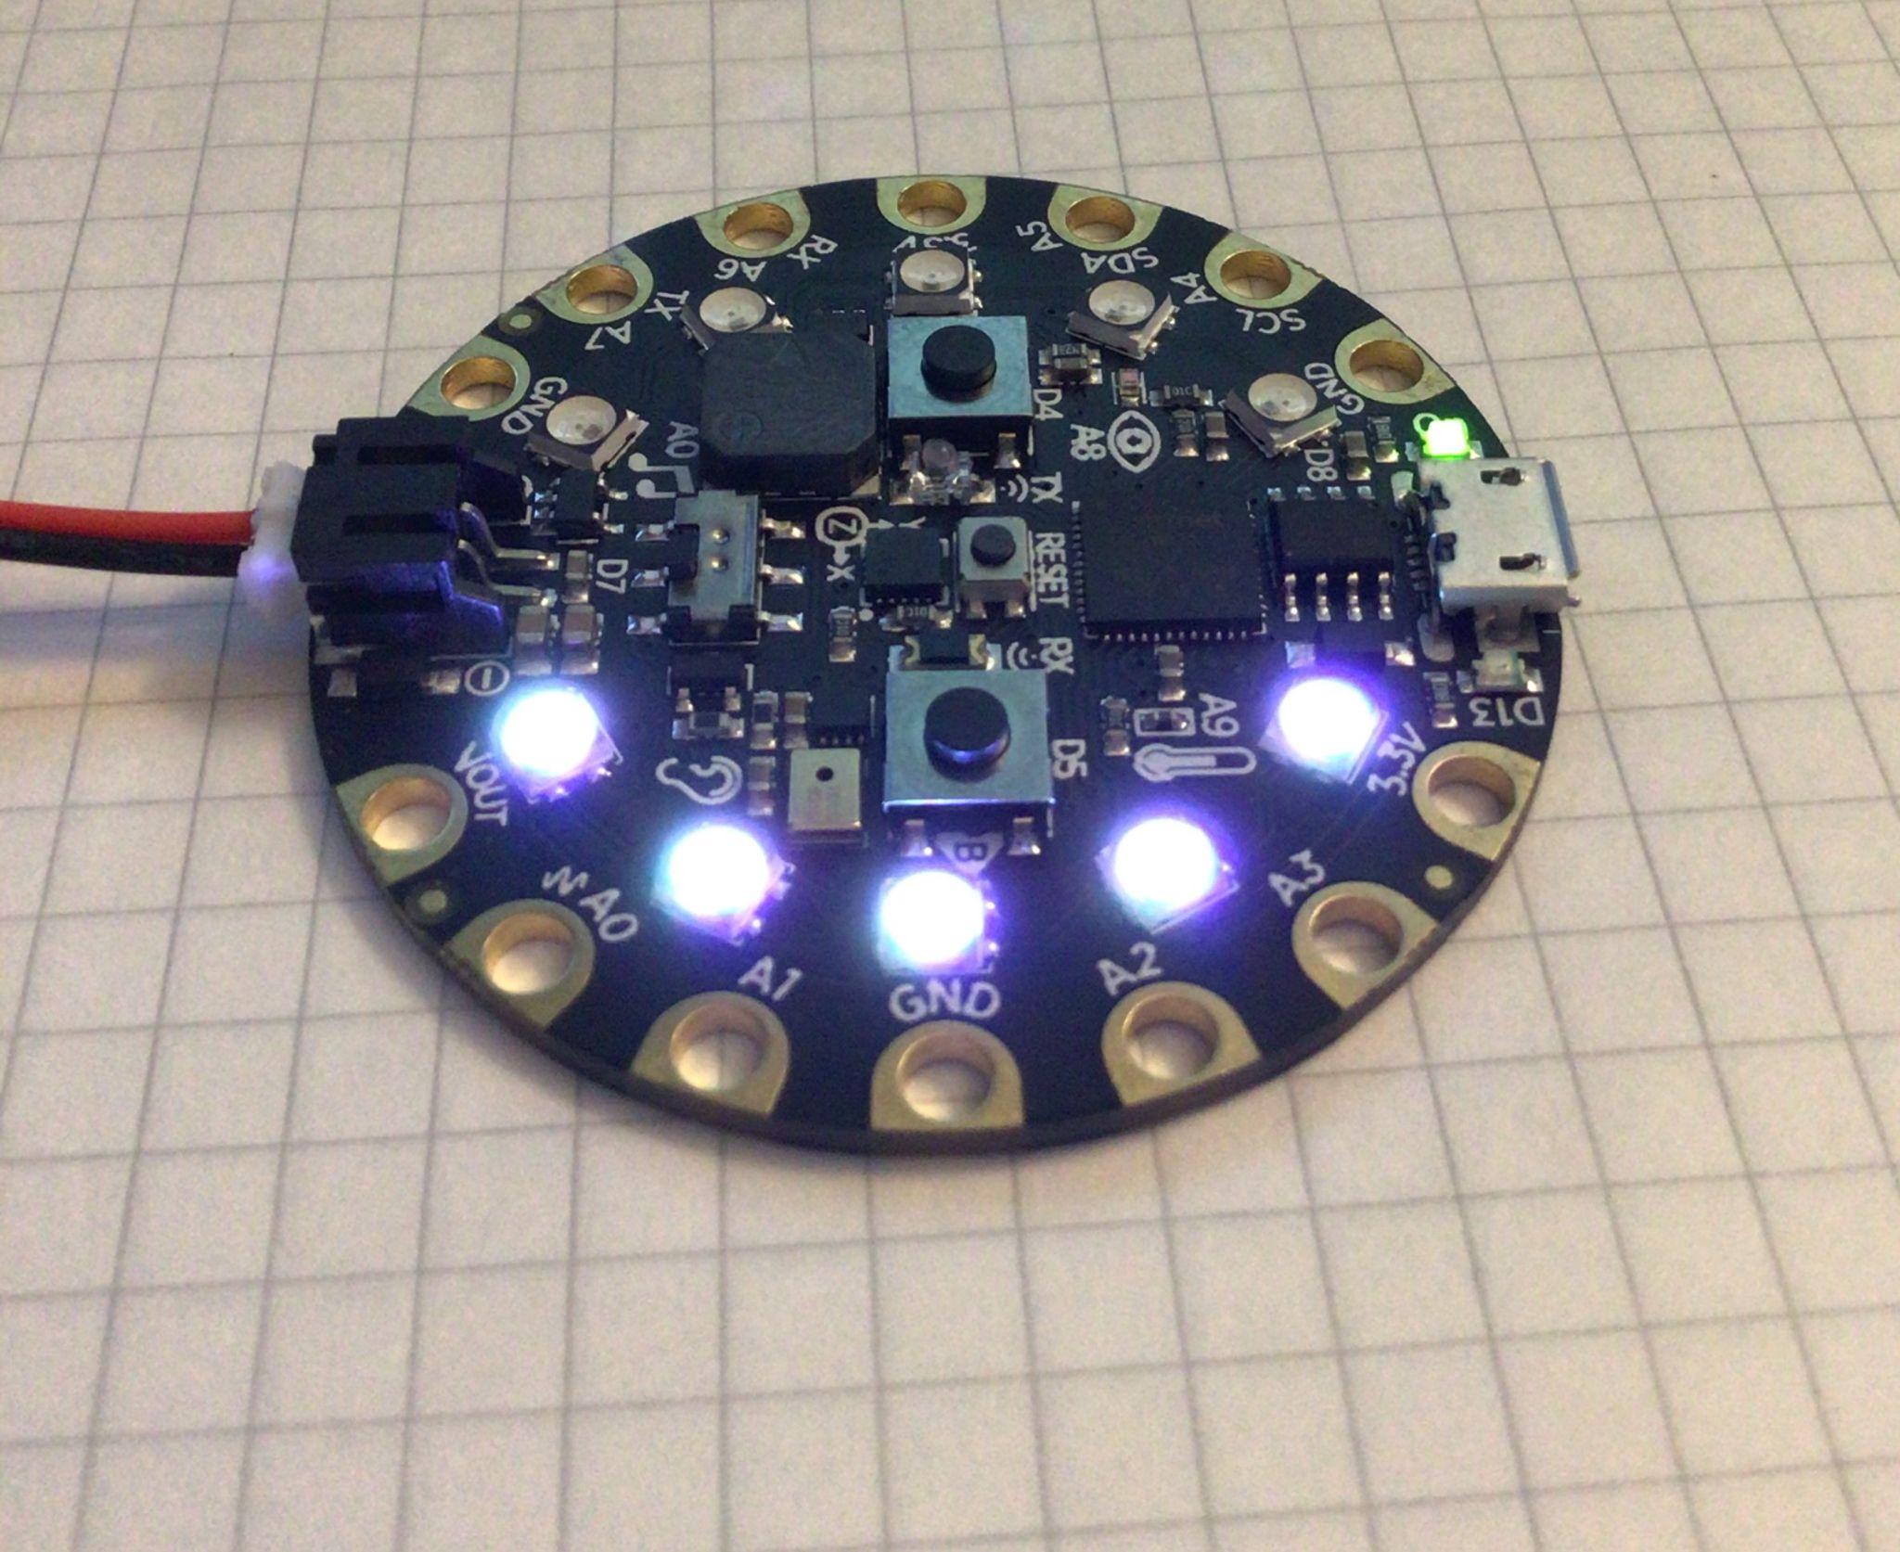
Smile Mode

Slide 12
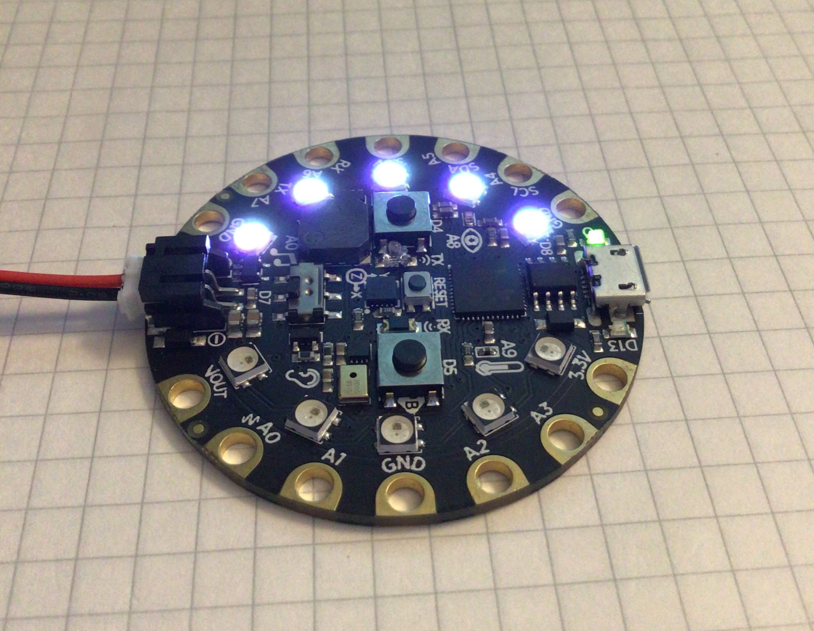
Frown Mode

Slide 13
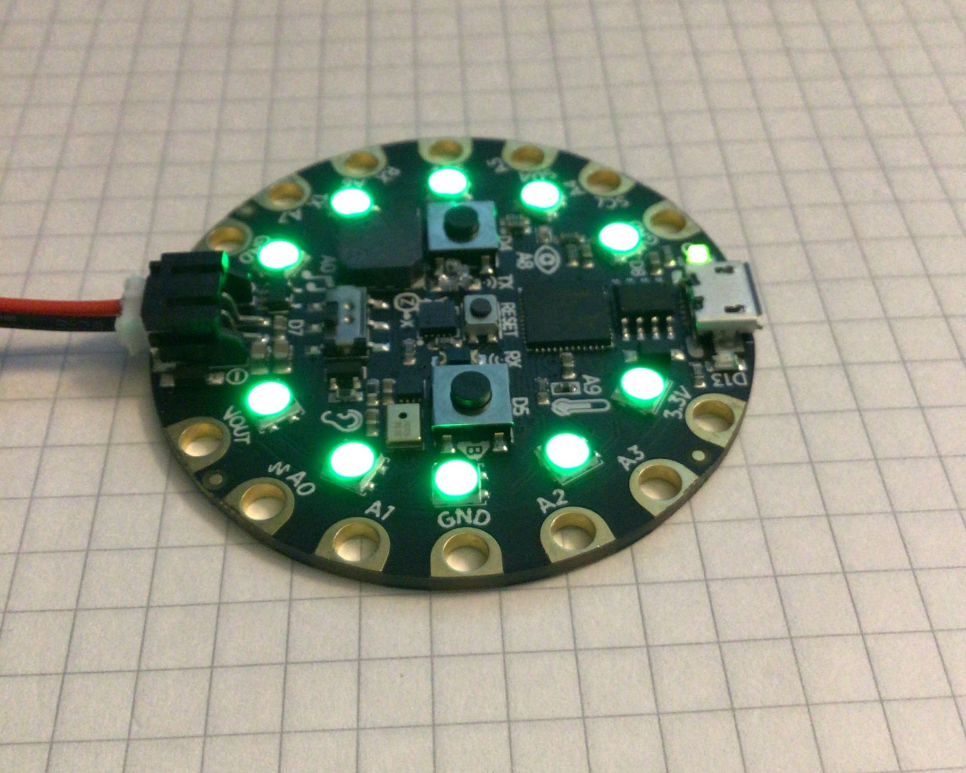
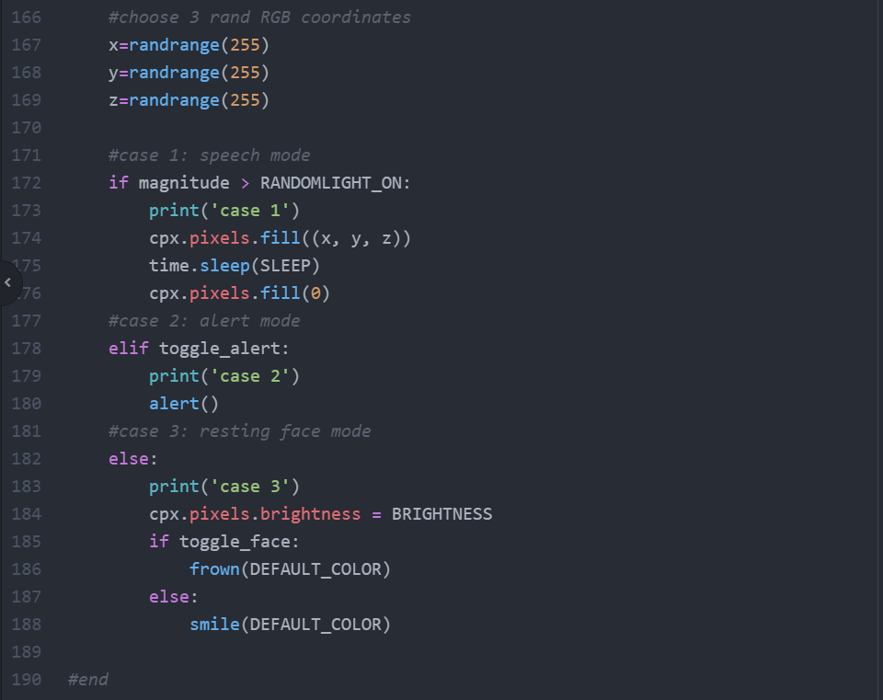
Random Color Mode

Slide 14
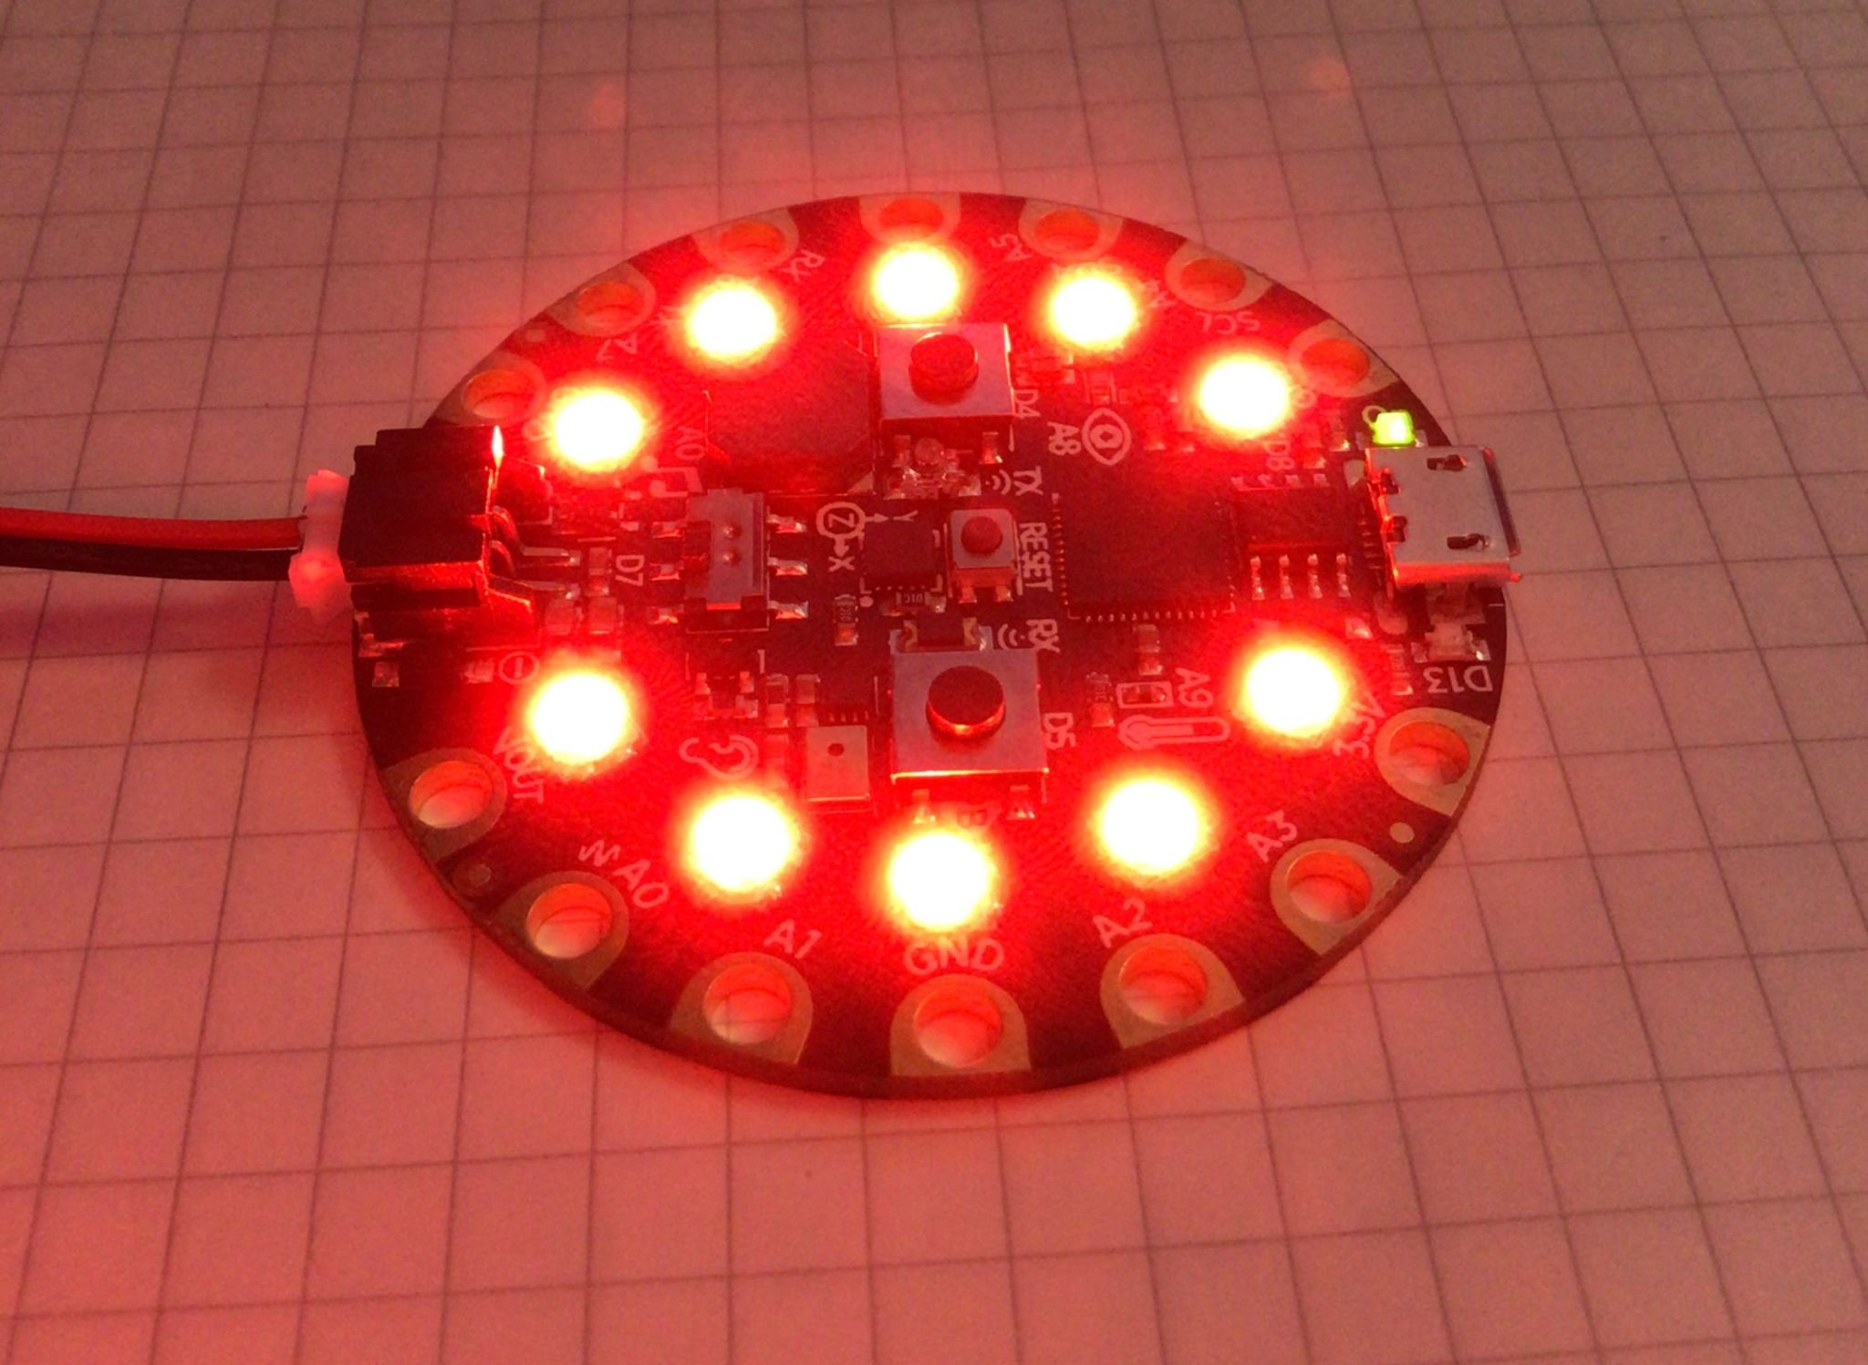
Alert Mode

Slide 15
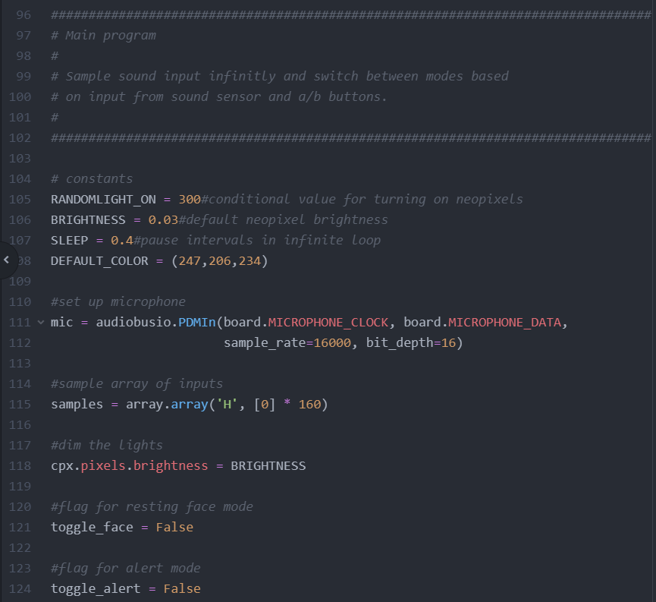
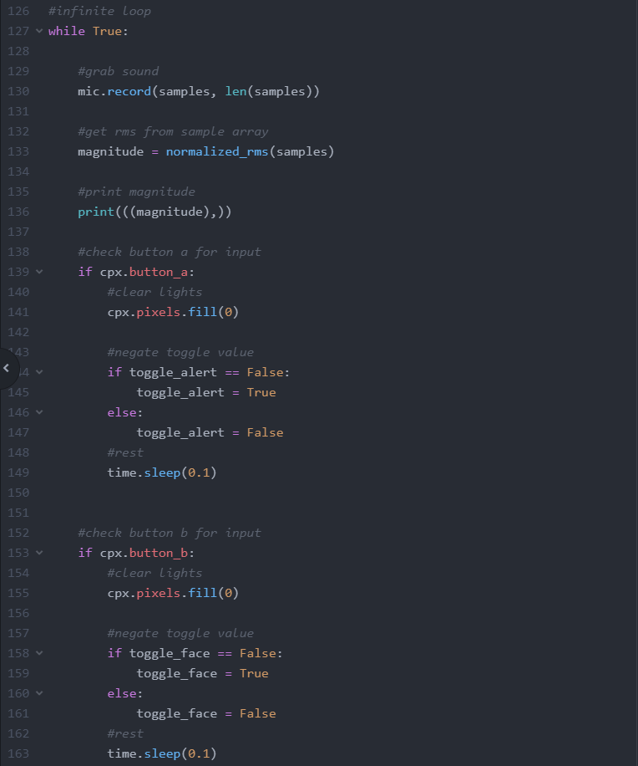
Used to toggle alert mode
Set up microphone for sound sampling
Used to toggle face mode

Slide 16
Random color if sound sample is greater than random light condition
If flag is true, call alert function
Otherwise call expression based on face flag

Slide 17

Development Problems
Adding proximity sensor
Playing a jiggle on start up
Triggering random color function with microcontroller input
Toggle mode
def darth_vadar():
A = 220
F = 174.61
C = 130.81
E = 164.81
theme =[A,A,A,F,C,A,F,C,A]
for i in theme:
print(i)
cpx.play_tone(i, 0.2)

Slide 18



Improvements:
-Audio Customization for Start Up
and voice amplifier
-Going solar for space reduction, battery pack too bulky
-More accurate and improve
blindspots for the proximity sensor

Slide 19


